Slide 1

Database Principles
CCS5001
Relational Database

Slide 2

Learning Objectives
01
The concept of a relational model
02
Constraints of relational models and database schemas
03
Design a relational database using ER
04
Mapping to a relational database

Slide 3
Relation
Definition: A relation is a named, two-dimensional table of data
Table is made up of rows (records), and columns (attribute or field)
Not all tables qualify as relations
Requirements:
Every relation has a unique name.
Every attribute value is atomic (not multivalued, not composite)
Every row is unique (can’t have two rows with exactly the same values for all their fields)
Attributes (columns) in a table have unique names
The order of the columns is irrelevant
The order of the rows is irrelevant

Slide 4
What is atomic value?
This mean that in your table, for every row-by-column position (cell), there exists only one value - not an array or list of values:
NOT a Relation, since Items cell has many values
OrderID | CustID | Date | Items
1 | 4 | 4/11/02 | 5 Pencils, 3 Erasers, 6 Rulers
2 | 23 | 6/11/02 | 1 Scissor
3 | 15 | 7/11/02 | 2 Pen, 2 Notebook
4 | 2 | 7/11/02 | 15 5" Magazine File
5 | 23 | 7/11/02 | 1 Stapler
6 | 2 | 8/11/02 | 5 Kingston USB Flash Drive 8GB

Slide 5
Is this a relation?
Still NOT a relation, since Items cell multi- value
OrderID | CustID | Date | Quantity | Items
1 | 4 | 4/11/02 | 5 | Pencils, Erasers, Rulers
2 | 23 | 6/11/02 | 1 | Scissor
3 | 15 | 7/11/02 | 2 | Pen, Notebook
4 | 2 | 7/11/02 | 15 | 5" Magazine File
5 | 23 | 7/11/02 | 1 | Stapler
6 | 2 | 8/11/02 | 5 | Kingston USB Flash Drive 8GB

Slide 6
Is this a relation?
A Relation, since Items cell has single value, and quantity is separated as a new column
OrderID | CustID | Date | Quantity | Items
1 | 4 | 4/11/02 | 5 | Pencils
1 | 4 | 4/11/02 | 3 | Erasers
1 | 4 | 4/11/02 | 6 | Rulers
2 | 23 | 6/11/02 | 1 | Scissor
3 | 15 | 7/11/02 | 2 | Pen
3 | 15 | 7/11/02 | 2 | Notebook
4 | 2 | 7/11/02 | 15 | 5" Magazine File
5 | 23 | 7/11/02 | 1 | Stapler
6 | 2 | 8/11/02 | 5 | Kingston USB Flash Drive 8GB

Slide 7
Example
Not a Relation, since EMP_No and EMP_Name cells have many values
DEPT_NO
MANAGER_NO
EMP_NO
EMP_NAME
D101
12345
2000 2001 2002
Carl Sagan Magic Johnson Larry Bird
D102
13456
3000 3001
Jimmy Carter Paul Simon

Slide 8
…and now, is this a relation?
A Relation, since EMP_No and EMP_Name cells have single values
Dept_No | Manager_No | Emp_No | Emp_Name
D101 | 12345 | 2000 | Carl Sagan
D101 | 12345 | 2001 | Magic Johnson
D101 | 12345 | 2002 | Larry Bird
D102 | 13456 | 3000 | Jimmy Carter
D102 | 13456 | 3001 | Paul Simon

Slide 9
Correspondence with ER Model
Relations (tables) correspond with entity types, multivalued attribute and with many-to-many relationship types
Rows correspond with entity instances and with many-to-many relationship instances
Columns correspond with attributes
ENTITY
ATTRIBUTE
RELATIONSHIP
ATTRIBUTE

Slide 10
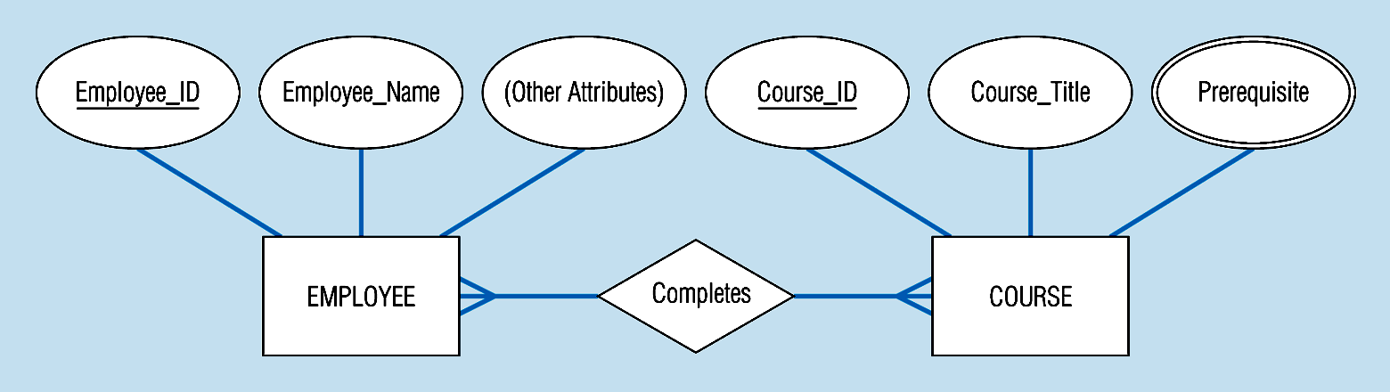
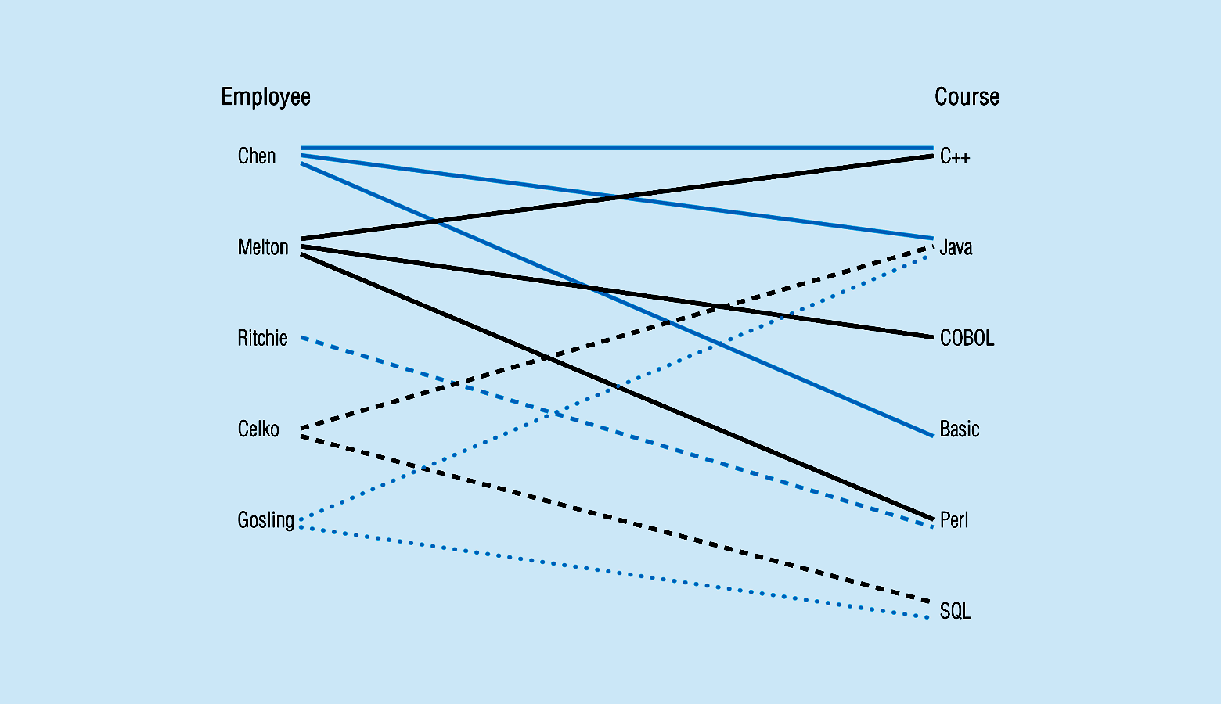
EXAMPLE
Entity and Relationship instances

Slide 11
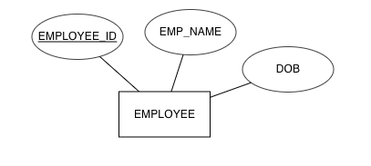
ENTITY TYPE → EMPLOYEE
EMPLOYEE
EMPLOYEE
EMPLOYEE_ID | EMP_NAME | DOB
1001 | CHEN | 12-FEB-1970
1002 | MELTON | 19-AUG-1986
1003 | RITCHIE | 26-MAR-1992
1004 | CELKO | 10-JUL-1990
1005 | GOSLING | 03-MAY-1976
Entity Instances (rows)

Slide 12
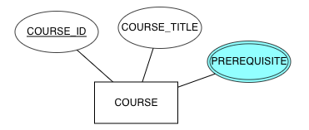
MULTIVALUED→PREREQUISITE
COURSE
COURSE_ID | COURSE_TITLE | PREREQUISITE
C1 | PROBLEM SOLVING | NULL
C2 | JAVA | C1
C3 | C# | C1
C4 | DATA STRUCTURE | C2, C3
C5 | RELATIONAL DATABASE | C4
C6 | SQL | C5
C7 | WEB APPLICATION DEVELOPMENT | C6, C8
C8 | SPRINGBOOT | C2
multivalued

Slide 13
MULTIVALUED→PREREQUISITE
COURSE
COURSE-PREREQUISITE
COURSE_ID | COURSE_TITLE
C1 | PROBLEM SOLVING
C2 | JAVA
C3 | C#
C4 | DATA STRUCTURE
C5 | RELATIONAL DATABASE
C6 | SQL
C7 | WEB APPLICATION DEVELOPMENT
C8 | SPRINGBOOT
COURSE_ID | PREREQUISITE
C1 | NULL
C2 | C1
C3 | C1
C4 | C2
C4 | C3
C5 | C4
C6 | C5
C7 | C6
C7 | C8
C8 | C2

Slide 14
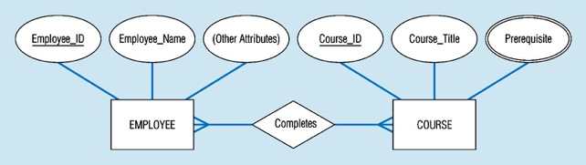
MANY-TO-MANY RELATIONSHIP
COMPLETED_COURSE
EMPLOYEE_ID | COURSE_ID
1001 | C1
1001 | C2
1001 | C4
1002 | C1
1002 | C3
1002 | C5
1003 | C5
1004 | C2
1004 | C6
1005 | C2
1005 | C6
COURSE
COURSE_ID | COURSE_TITLE
C1 | PROBLEM SOLVING
C2 | JAVA
C3 | C#
C4 | DATA STRUCTURE
C5 | RELATIONAL DATABASE
C6 | SQL
C7 | WEB APPLICATION DEVELOPMENT
C8 | SPRINGBOOT

Slide 15
Key
Keys are special fields that serve two main purposes:
Primary keys are unique identifiers of the relation in question. Examples include employee numbers, social security numbers, etc. This is how we can guarantee that all rows are unique
Foreign keys are identifiers that enable a dependent relation (on the many side of a relationship) to refer to its parent relation (on the one side of the relationship)
Keys can be simple (a single field) or composite (more than one field)
Keys usually are used as indexes to speed up the response to user queries.

Slide 16
Transforming ER into Relation
Step 1: Mapping Regular Entities to Relations
Simple attributes: E-R attributes map directly onto the relation
Composite attributes: Use only their simple, component attributes
Multi-valued Attribute - Becomes a separate relation with a foreign key taken from the superior entity

Slide 17
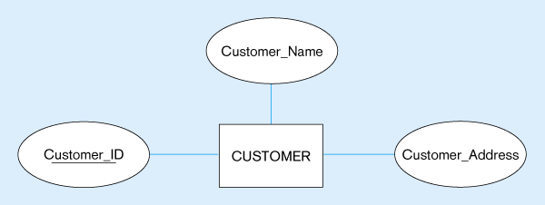
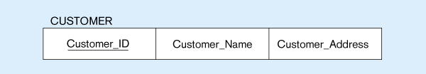
i. Mapping a regular entity with simple attribute
(a) CUSTOMER entity type with simple attributes
(b) CUSTOMER relation

Slide 18
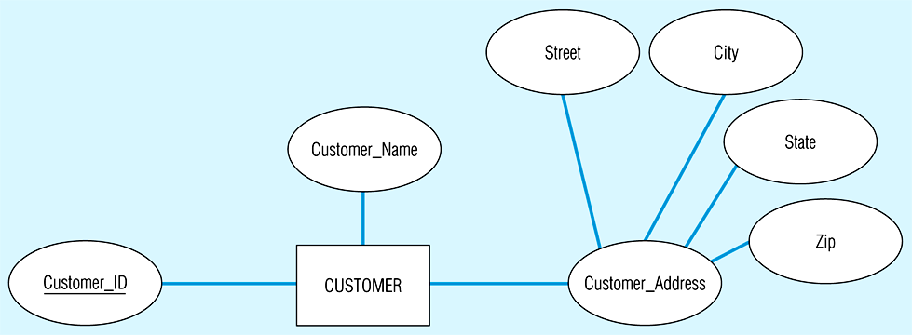
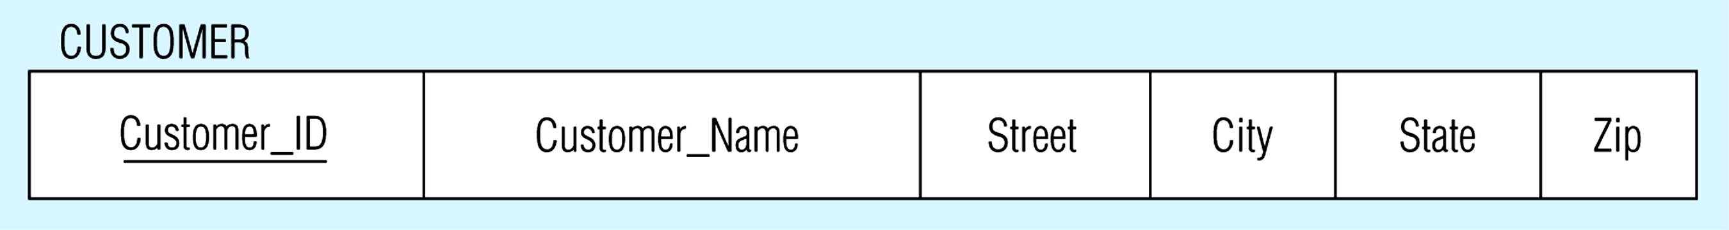
ii. Mapping a regular entity with composite attributes
(a) CUSTOMER entity type with composite attribute
(b) CUSTOMER relation with address detail

Slide 19
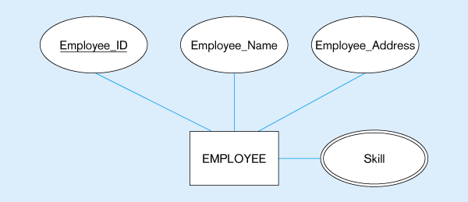
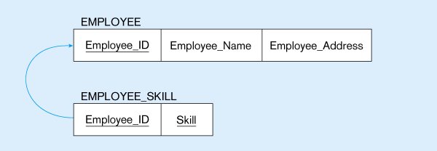
iii. Mapping regular entity with a multivalued attribute
(a)
Multivalued attribute becomes a separate relation with foreign key
(b)
1 – to – many relationship between original entity and new relation

Slide 20
Transforming ER into Relation
Step 2: Mapping Weak Entities
Becomes a separate relation with a foreign key taken from the superior entity
Primary key composed of:
Partial identifier of weak entity
Primary key of identifying relation (strong entity)

Slide 21
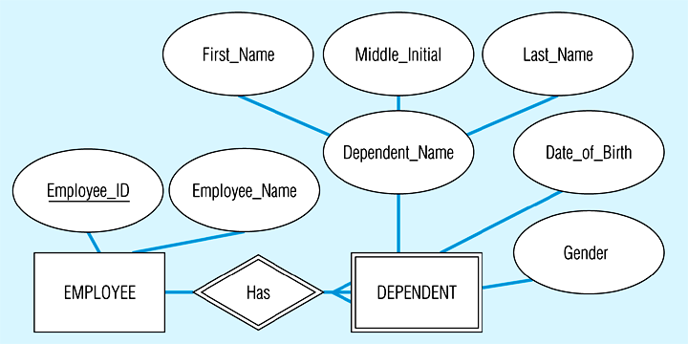
Mapping a weak entity
(a) Weak entity DEPENDENT

Slide 22
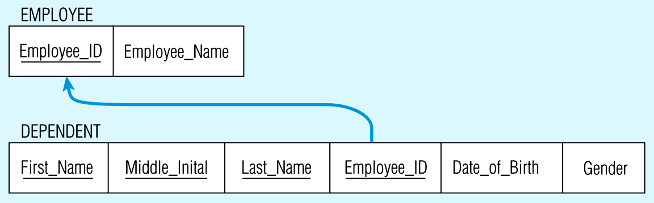
(b) Relations resulting from weak entity
NOTE: the domain constraint for the foreign key should NOT allow null value if DEPENDENT is a weak entity
Foreign key
Composite primary key

Slide 23
Transforming ER into Relation
Step 3: Mapping Binary Relationships
One-to-Many - Primary key on the one side becomes a foreign key on the many side
Many-to-Many - Create a new relation with the primary keys of the two entities as its primary key
One-to-One - Primary key on the mandatory side becomes a foreign key on the optional side

Slide 24
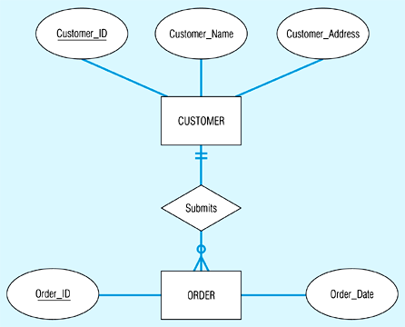
Mapping a 1:M relationship
(a) Relationship between customers and orders

Slide 25
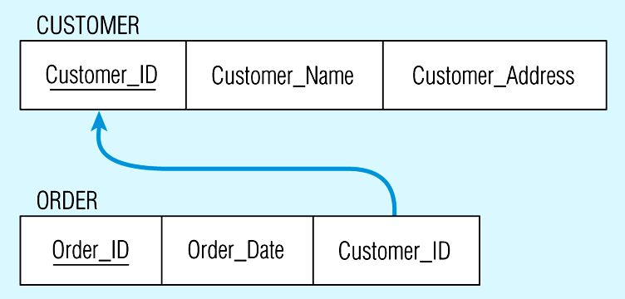
(b) Mapping the relationship
Again, no null value in the foreign key…this is because of the mandatory minimum cardinality
Foreign key

Slide 26
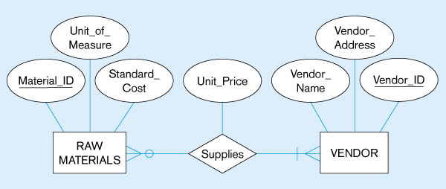
Mapping M:N relationship
(a) ER diagram (M:N)
The Supplies relationship will need to become a separate relation

Slide 27
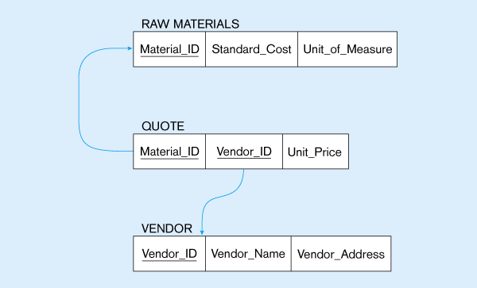
(b) Three resulting relations
Composite primary key
New intersection relation
Foreign key
Foreign key

Slide 28
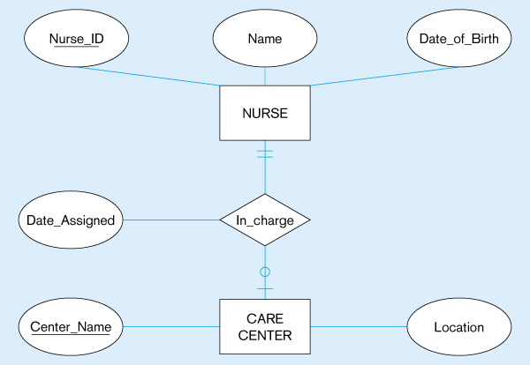
Mapping a binary 1:1 relationship
(a) Binary 1:1 relationship

Slide 29
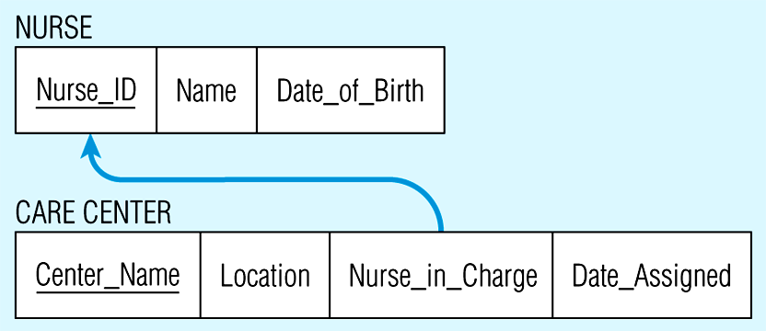
(b) Resulting relations

Slide 30
Transforming ER into Relation
Step 4: Mapping Associative Entities
Identifier Not Assigned
Default primary key for the association relation is composed of the primary keys of the two entities (as in M:N relationship)
Identifier Assigned
It is natural and familiar to end-users
Default identifier may not be unique

Slide 31
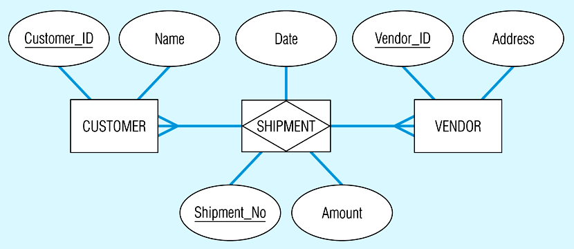
Mapping an associative entity
(a) Associative entity

Slide 32
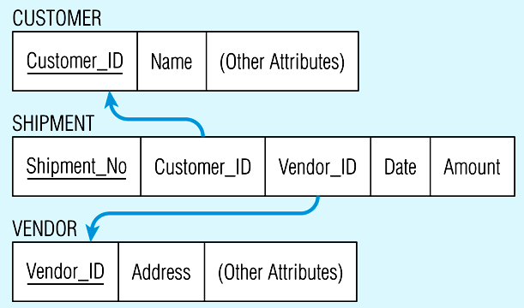
(b) Three resulting relations

Slide 33
Transforming ER into Relation
Step 5: Mapping Unary Relationships
One-to-Many - Recursive foreign key in the same relation
Many-to-Many - Two relations:
One for the entity type
One for an associative relation in which the primary key has two attributes, both taken from the primary key of the entity

Slide 34
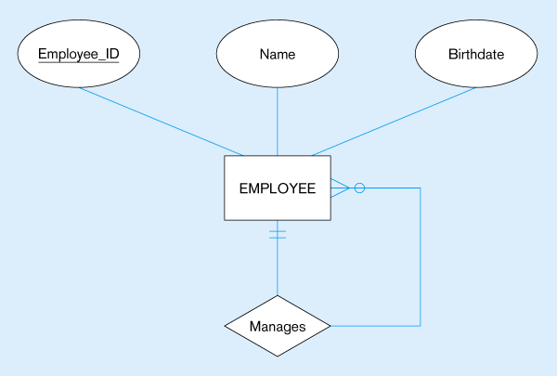

Mapping a unary 1:N relationship
(a) EMPLOYEE entity with Manages relationship
(b) EMPLOYEE relation with recursive foreign key

Slide 35
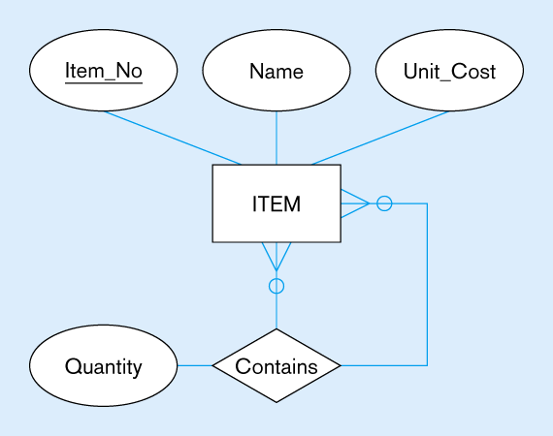
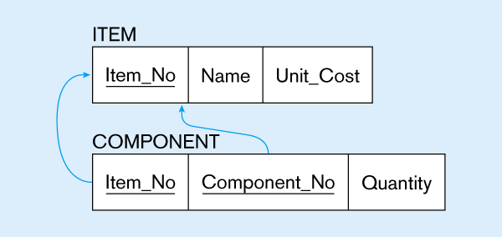
Mapping a unary M:N relationship
(a) Bill-of-materials relationships (M:N)
Composite primary key (Item_No, Component_No), and each of them is a foreign key referencing ITEM(Item_No)
(b) ITEM and COMPONENT relations

Slide 36
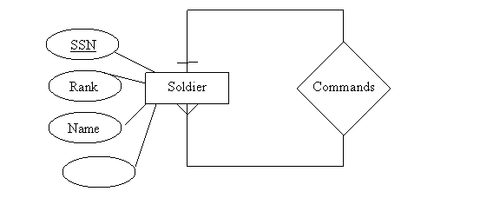
Practice 1
phone

Slide 37

Practice 2

Slide 38
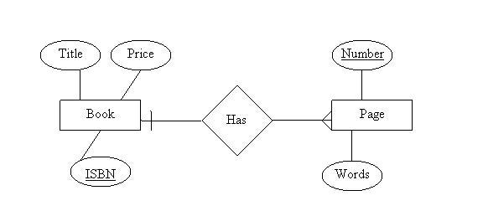
Practice 3

Slide 39
Practice 4

Slide 40
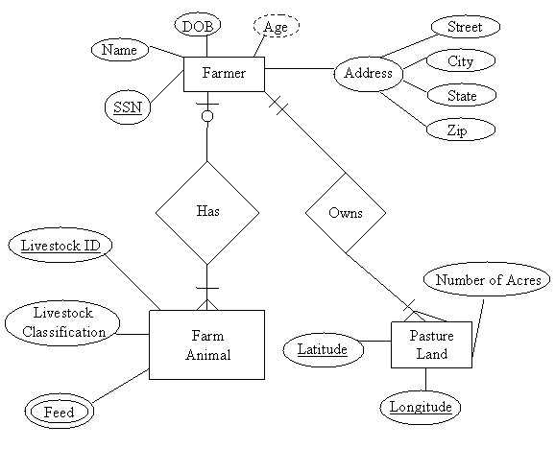
Practice 5

Slide 41
Practice 6

Slide 42
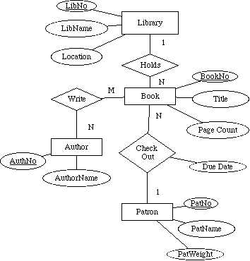
Practice 7

Slide 43

End of Chapter

